Slide 1

Be a Batman
See Motion in the Dark
R08921040 徐均筑
R08942087 吳彬睿
R08921098 蔣思揚
R08921115 林修同

Slide 2
INTRODUCTION
01
OUR METHODS
02
EXPERIMENT
03
CONCLUSION
04
．Task Description
．Related Work
．Idea
．Model
．Result
．Quantitative Analysis

Slide 3
01
INTRODUCTION

Slide 4
Task Description
We are interested in capturing videos of dynamic scenes in the dark.
People dancing in the moonlight
An intimate conversation by candlelight
Extreme low-light videography is challenging due to low photon counts.
Notes:
There are a lot of dark cases which we want to see clearly in our daily life.
MoonLight Dinner
Basketball Court
We want to capture videos of dynamic scenes in the dark
Difficulty: Quantization, Bias, Clipping

Slide 5
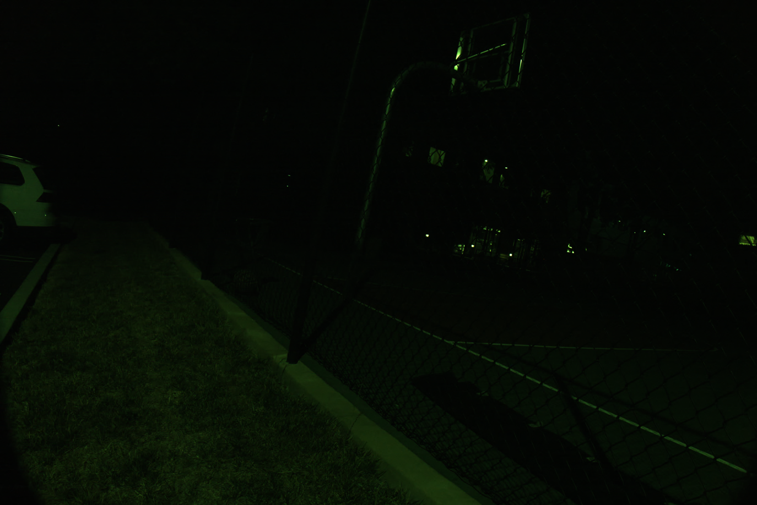
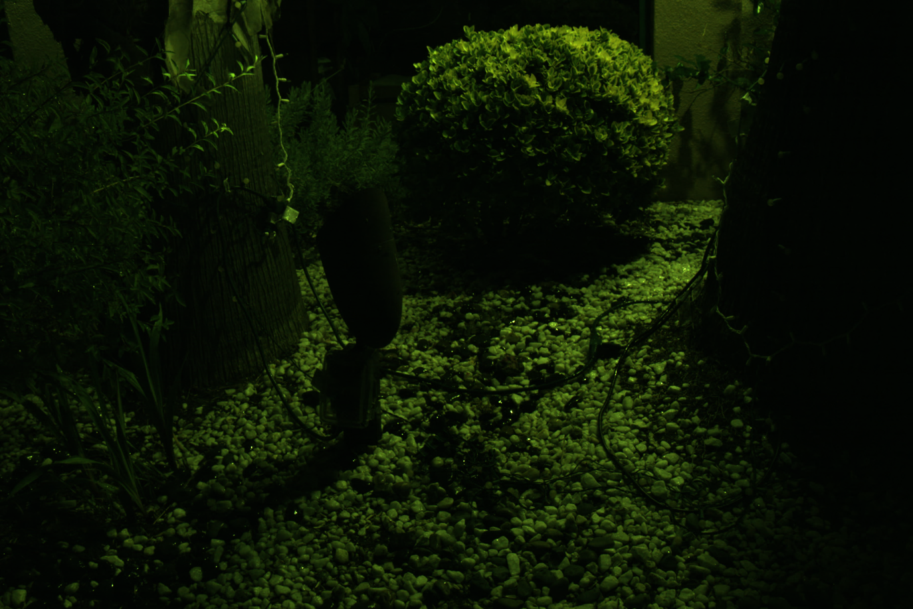
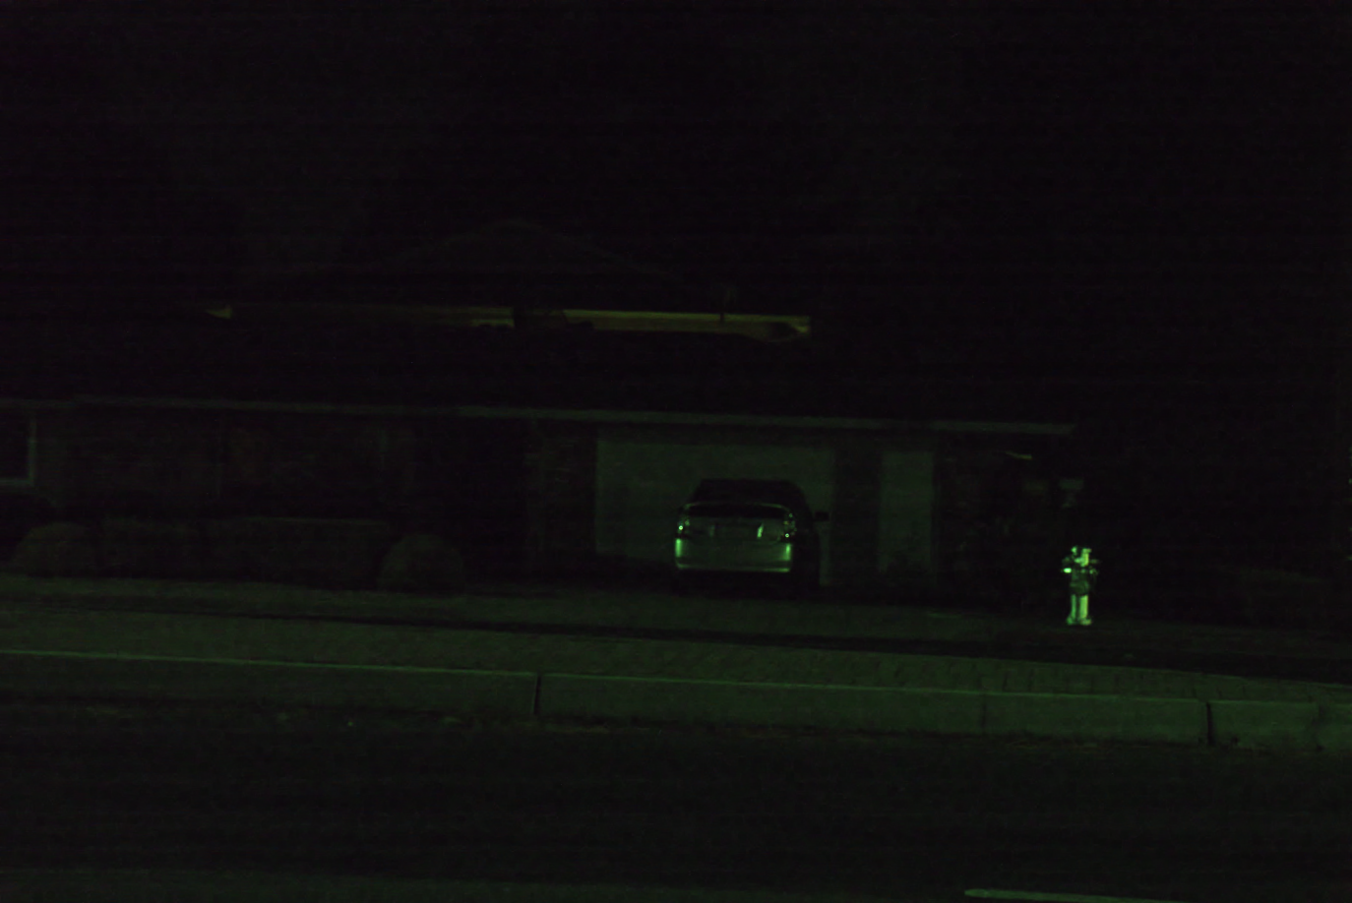
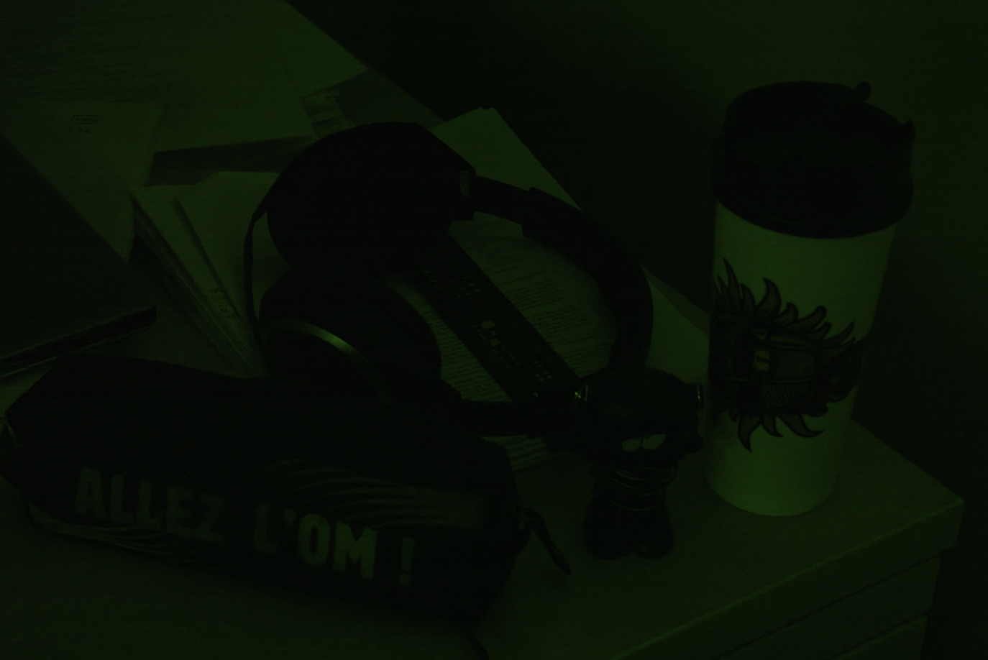
Example

Slide 6
Related Work
Learning to See in the Dark [1]
Extreme low-light image denoising
Seeing Motion in the Dark [2]
Extreme low-light video denoising

Slide 7
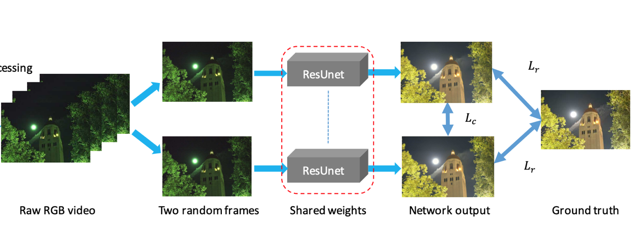
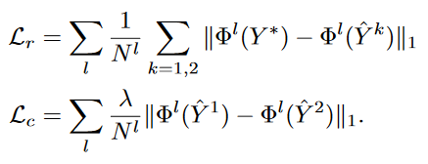
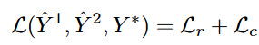
Related Work
Seeing Motion in the Dark [2]

Slide 8
02
OUR METHODS

Slide 9
Idea
By using proposed model in [2], we can conduct frame-by-frame processing on reference frames. However, it only consider one frame at a time during inference.
By taking consecutive reference frames into consideration, we may learn more useful information.

Slide 10
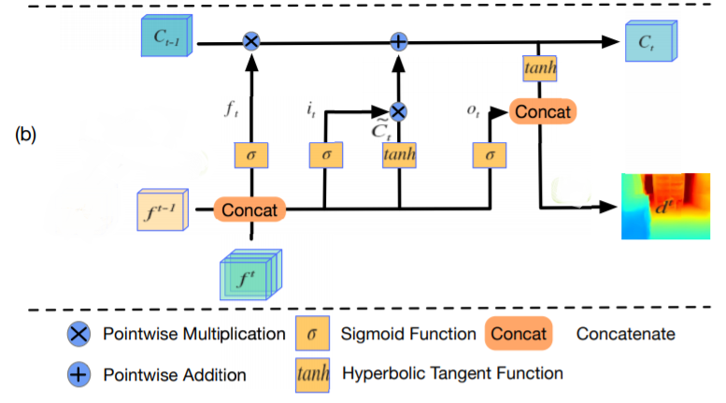
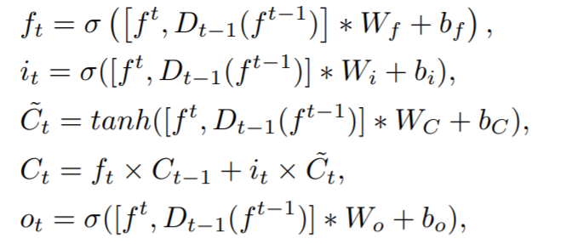
Model
Conv-LSTM [3]

Slide 11
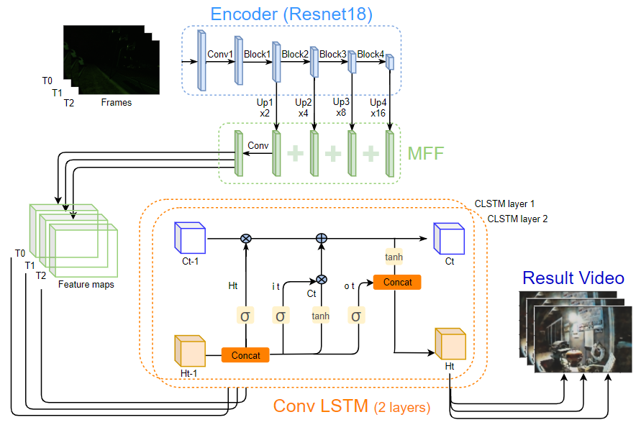
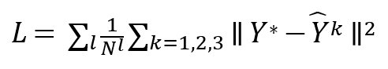
Model 1 ( Encoder+ MFF[3] + CLSTM )
Multi-scale Feature Fusion

Slide 12
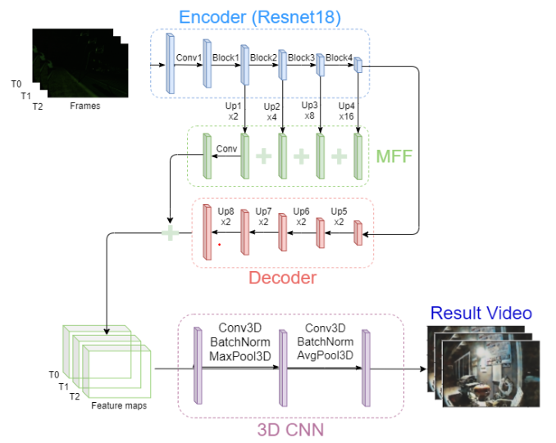
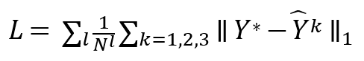
Model 2 ( Autoencoder + MFF + 3D CNN )

Slide 13
03
EXPERIMENT

Slide 14
Dark Raw video Dataset
Use a Sony RX100 VI camera, which can capture raw image sequences at approximately 16 to 18 frames per second in continuous shooting mode, and the buffer can keep around 110 frames in total.
This is equivalent to 5.5-second videos at 20 fps. The resolution for the Bayer image is 3672 × 5496.
The dataset contains both indoor and outdoor scenes.

Slide 15
Dark Raw video Dataset
There are 202 static videos for training and quantitative evaluation.
Most scenes in the dataset are in the 0.5 to 5 lux range.
We randomly divide them into approximately 64% for training, 12% for validation, and 24% for testing

Slide 16
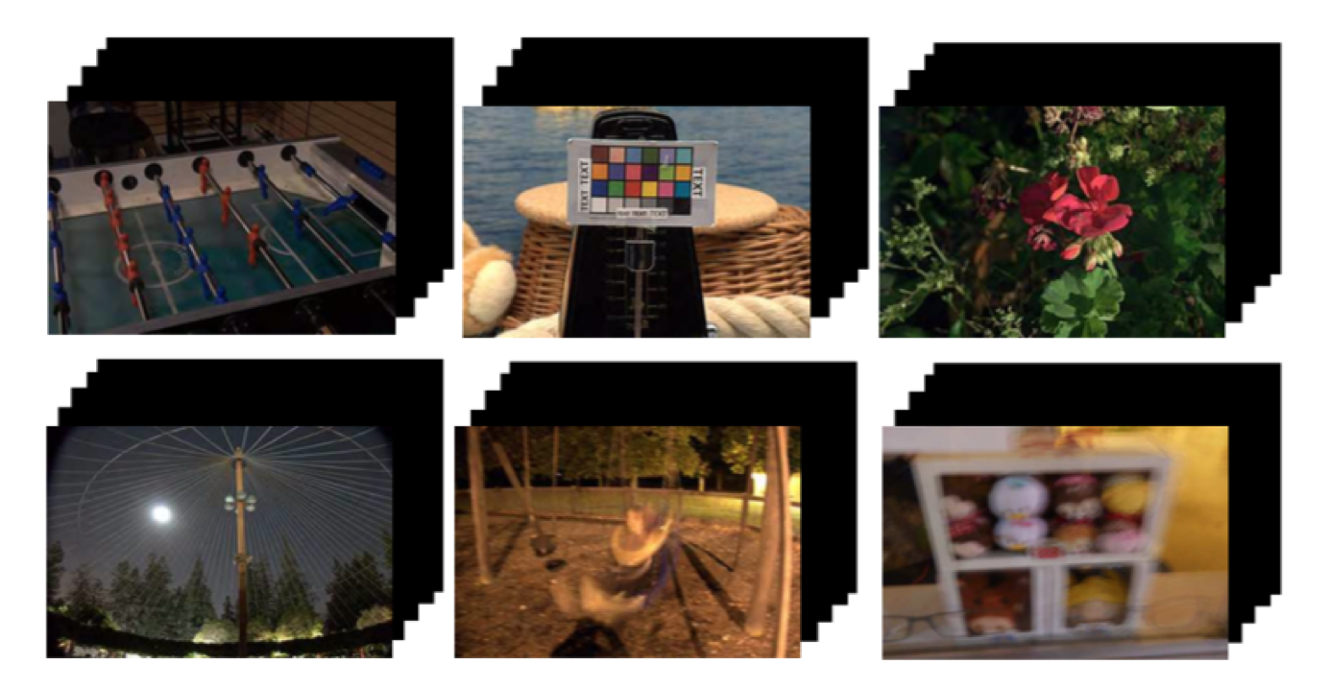
Dark Raw video Dataset

Slide 17
Training
GPU Nvidia GTX 1080Ti
Pytorch 1.3.1
model
Encoder + MFF + CLSTM
optimizer : AdamW
batchsize : 2
epochs : 1
Autoencoder + MFF + 3D CNN
optimizer : AdamW
batchsize : 2
epochs : 4

Slide 18
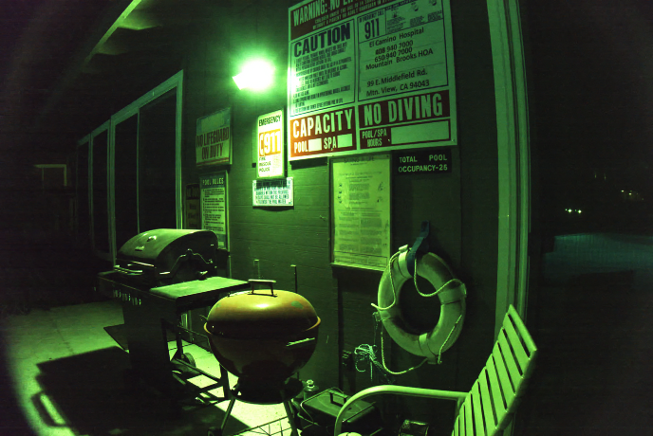
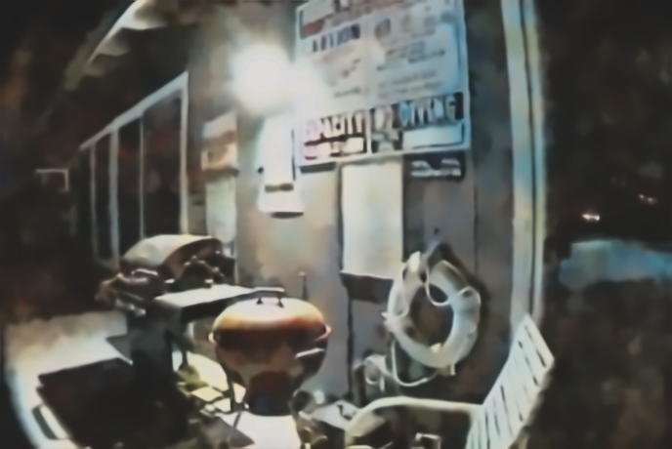
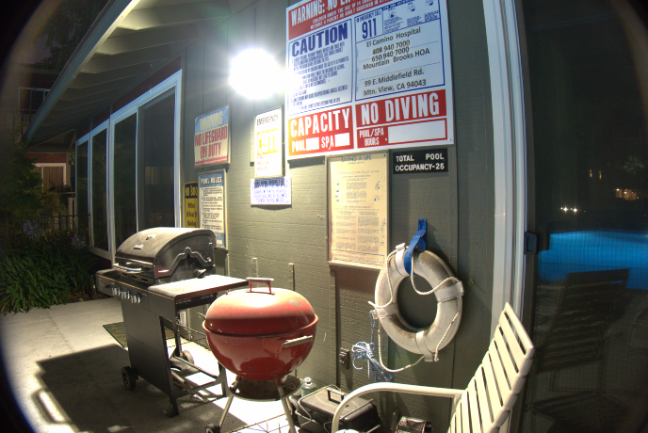
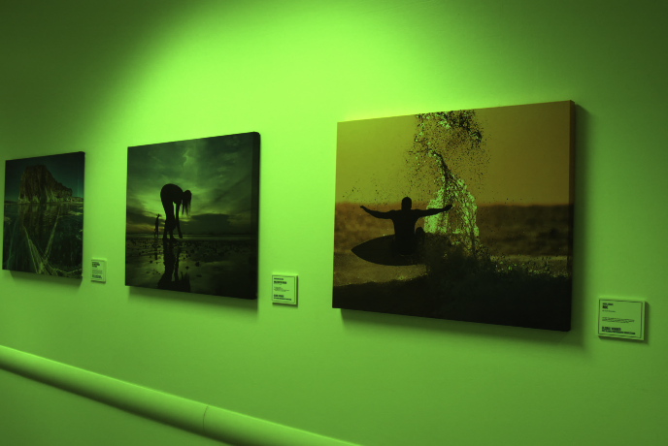
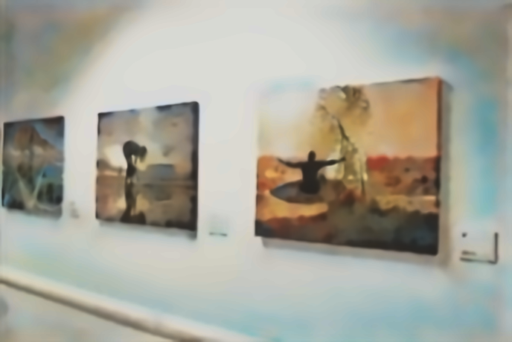
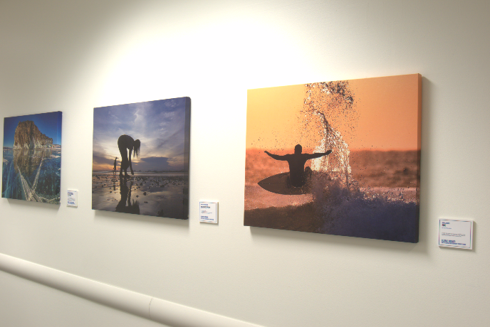
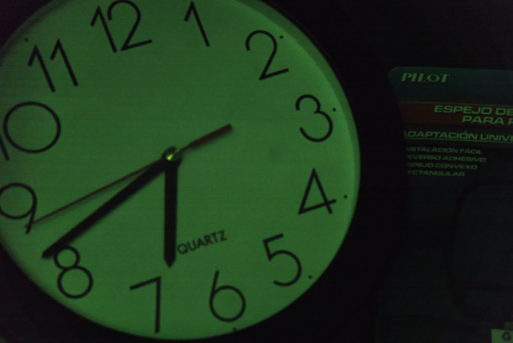
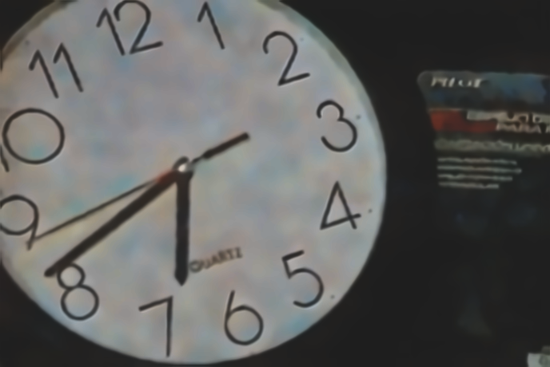
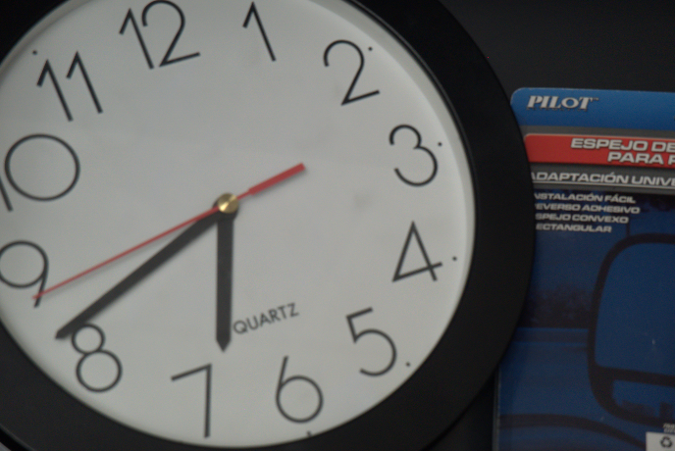
Results: Positive Examples
Raw+VBM4D
Our Result (Model 1)
GroundTruth

Slide 19
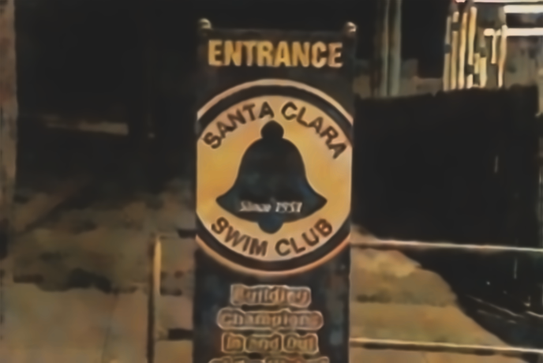
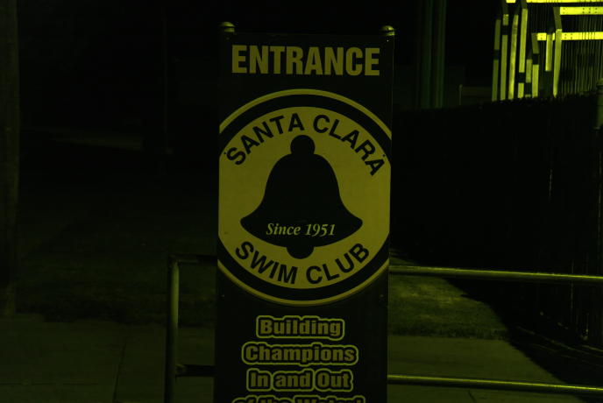
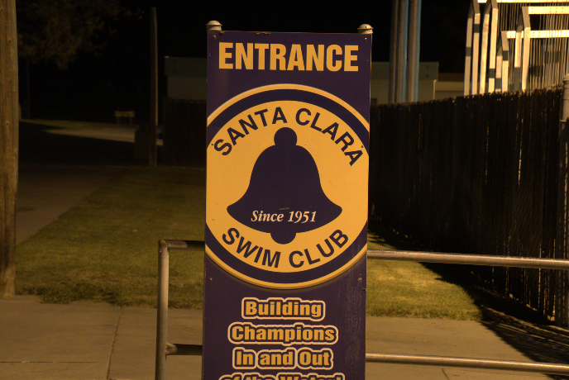
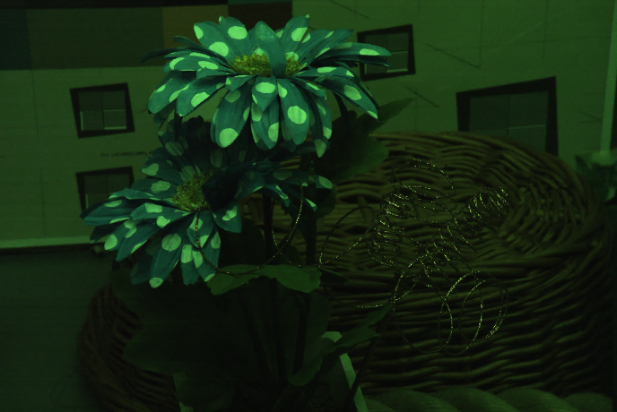
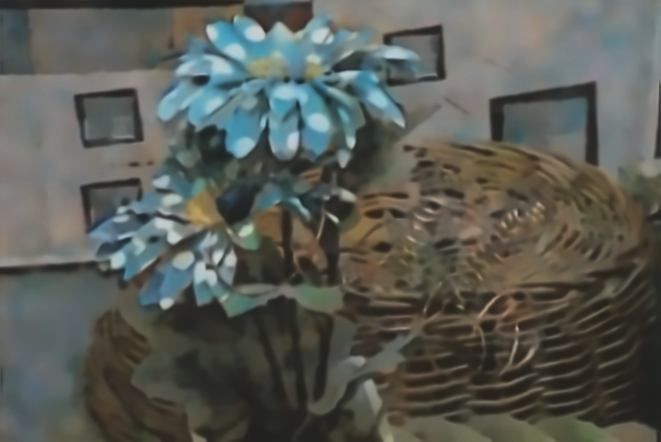
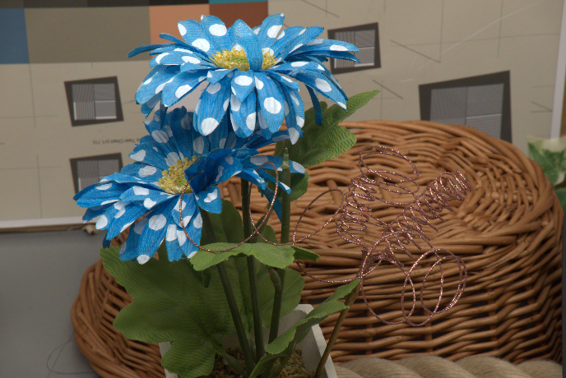
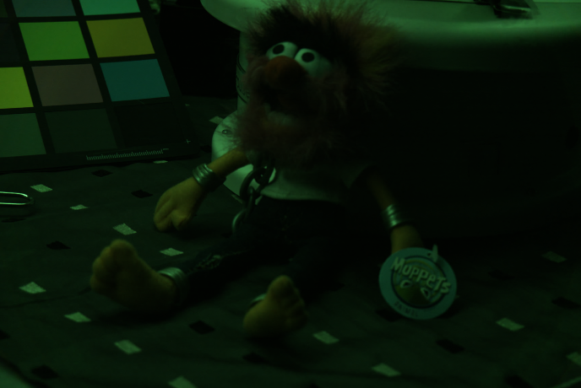
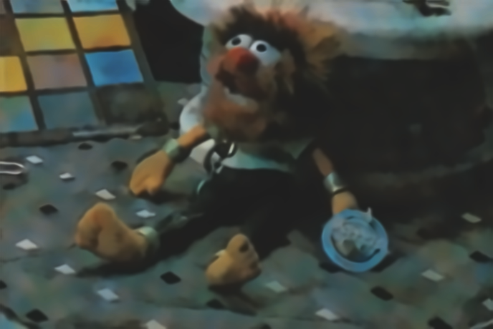
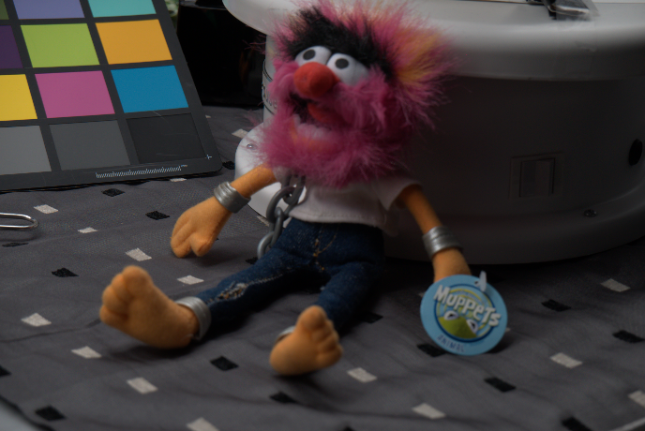
Results: Positive Examples
Raw+VBM4D
Our Result (Model 1)
GroundTruth

Slide 20
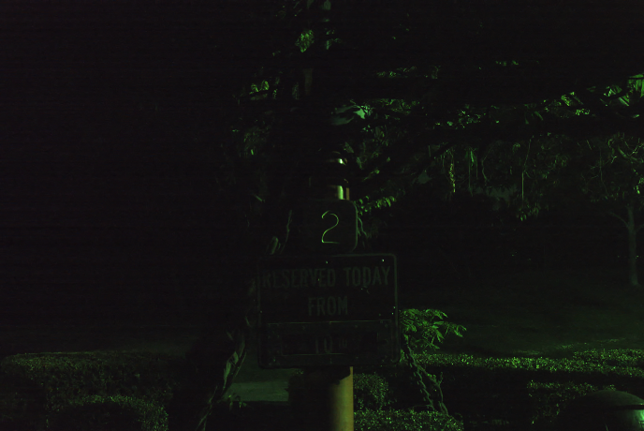
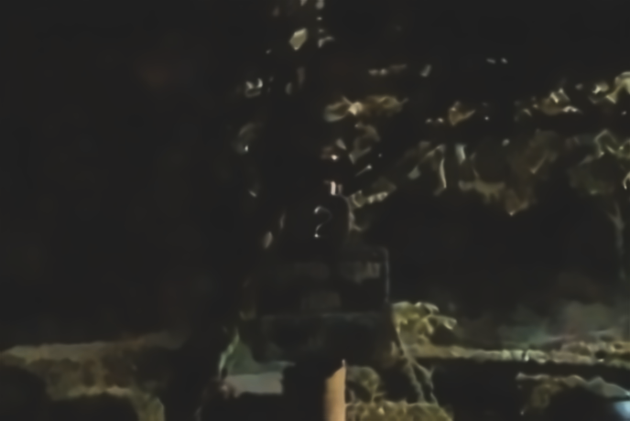
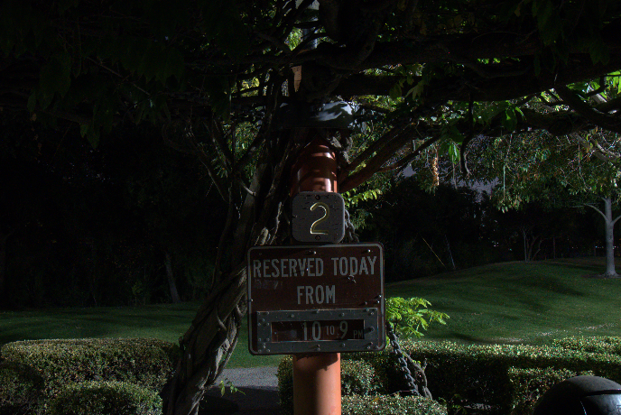
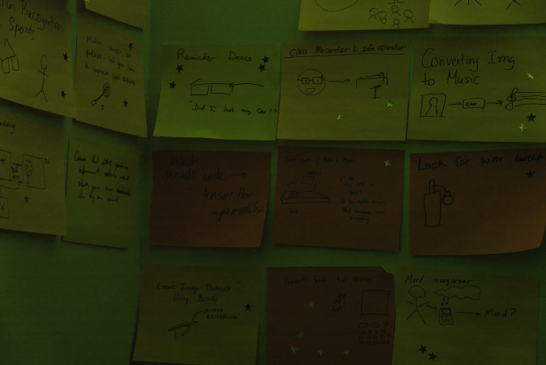
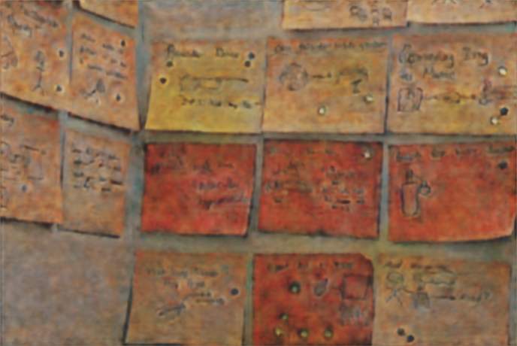
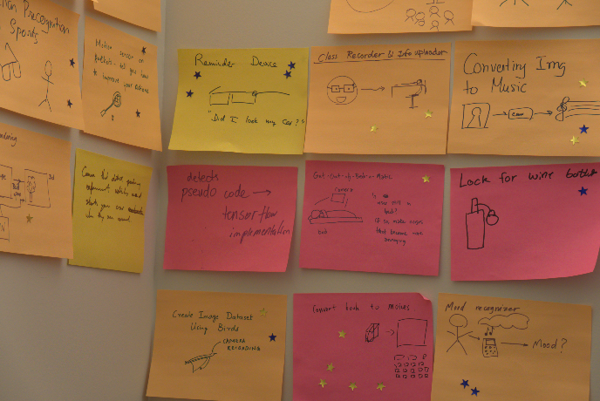
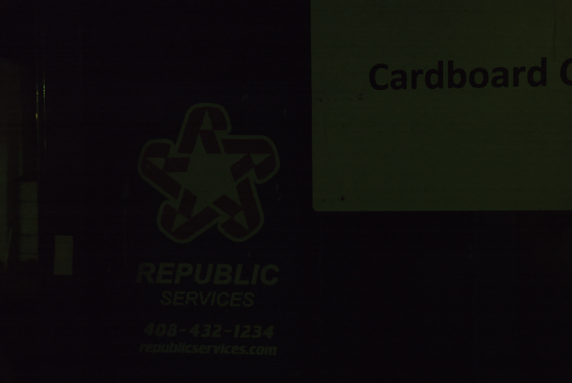

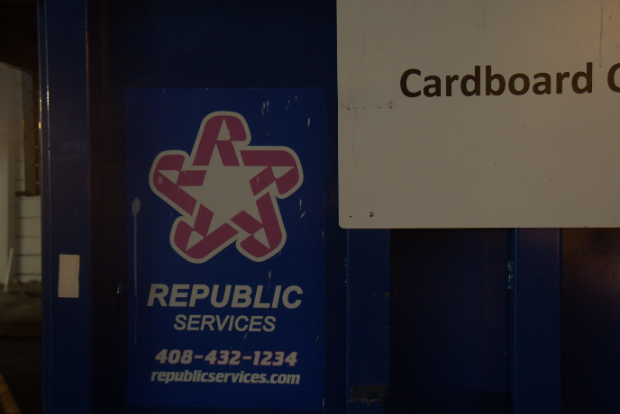
Results: Failure Examples
Raw+VBM4D
Our Result (Model 1)
GroundTruth

Slide 21
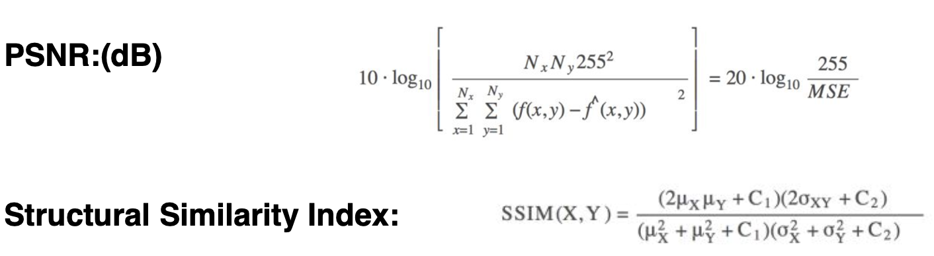
Quantitative Analysis

Slide 22
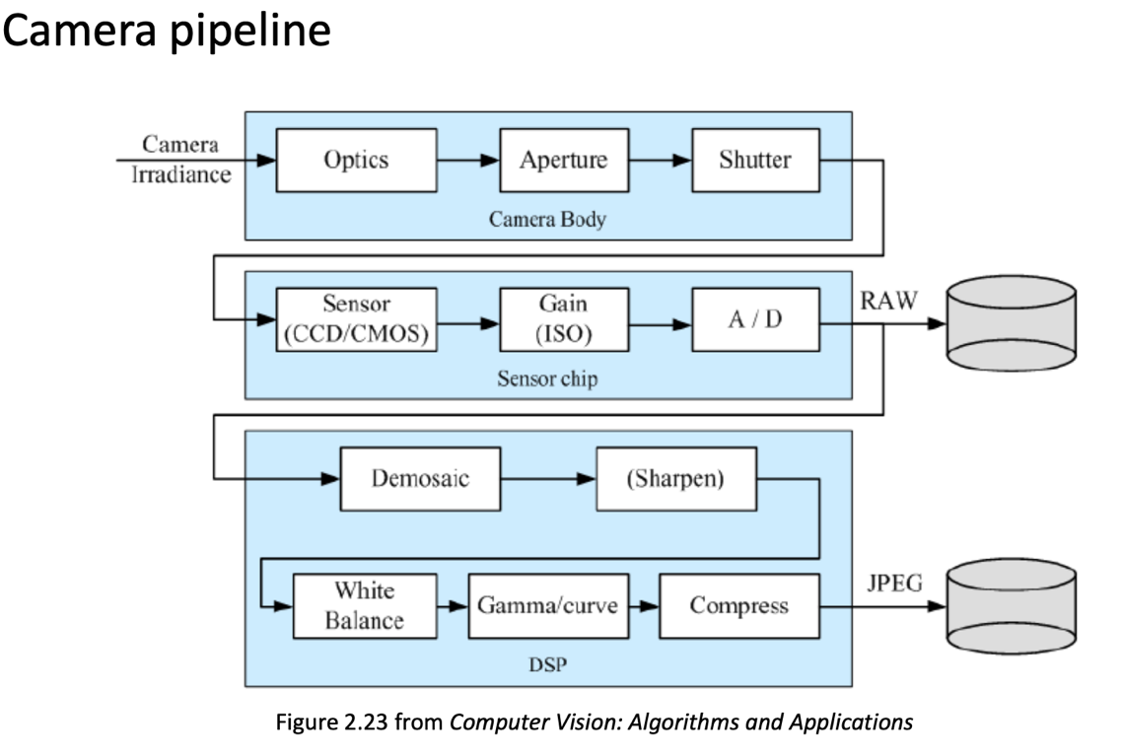
Quantitative Analysis

Slide 23
Quantitative Analysis
Frame Quality evaluation
Temporal consistency evaluation
Input+Rawpy
VBM4D+Rawpy
SMID [2]
CLSTM
3D CNN
PSNR (dB)
12.94
14.77
28.26
18.42
17.18
SSIM
0.165
0.315
0.815
0.593
0.615
SID [1] w/o VBM4D
SMID [2]
CLSTM
3D CNN
TPSNR (dB)
33.72
38.31
29.32
35.31
TSSIM
0.939
0.974
0.924
0.964
TMAE (x100)
1.56
0.89
2.85
1.38
Notes:
2. batch norm (batch size samll) & perceptual loss (pretrain VGG) l1 loss looks simliar input size large

Slide 24
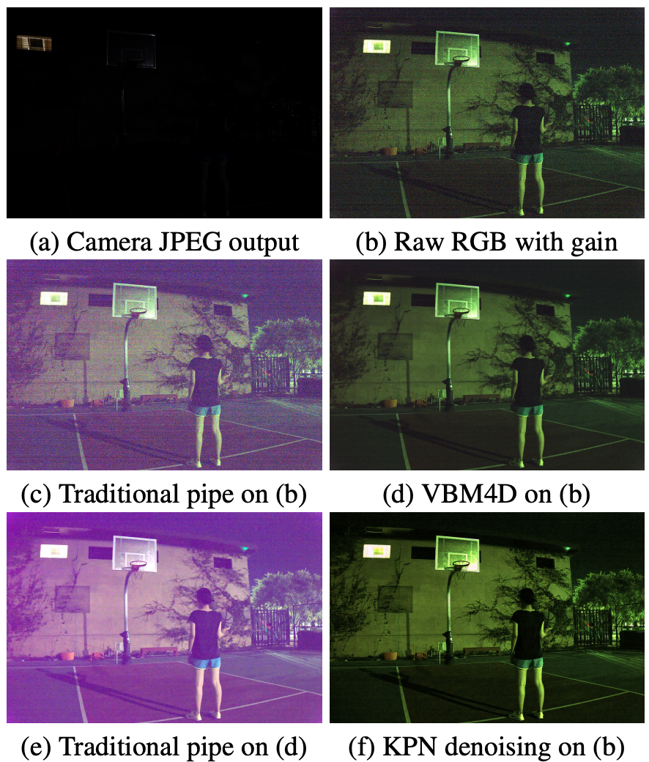
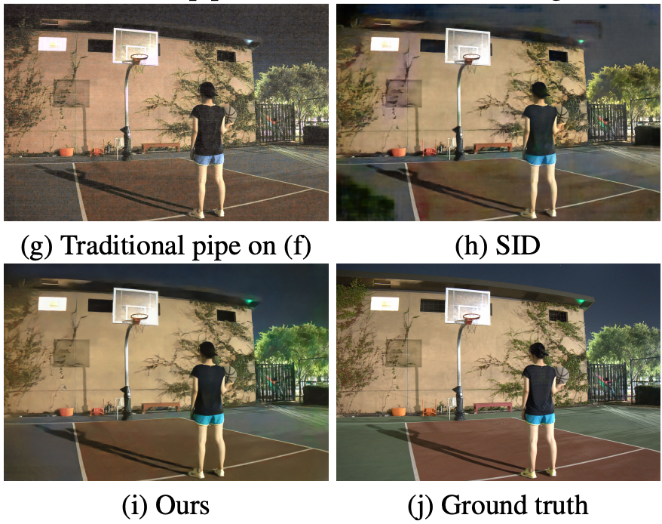
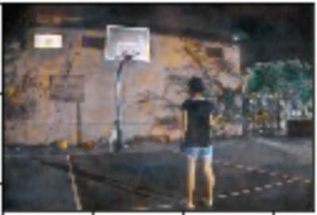
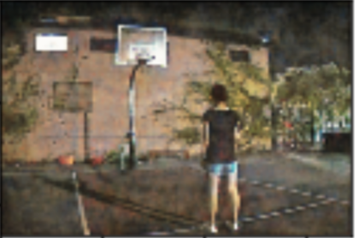
Results
3DCNN
CLSTM
Notes:
3DCNN blurry comare with CLSTM

Slide 25
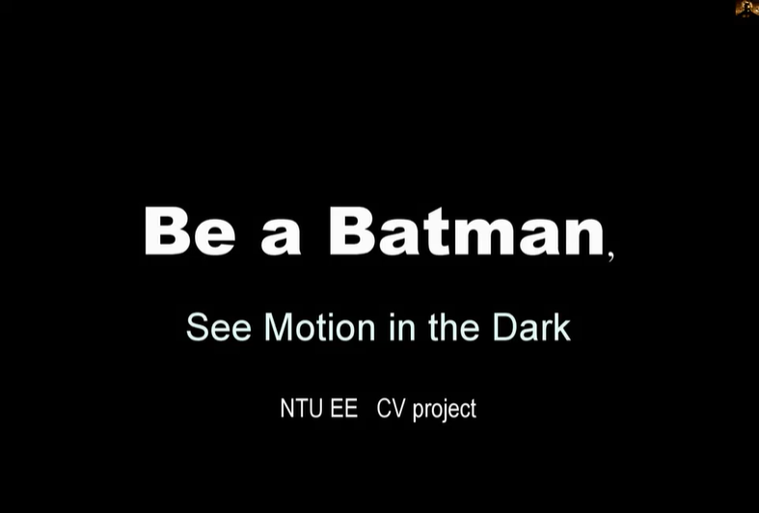
Demo

Slide 26
Conclusion
We consider the relation between consecutive reference frames using CLSTM/3D CNN.
Quantitative and qualitative analysis demonstrate that our method achieves promising results compared with other traditional pipelines but there is still room for improvement.
While 3D CNN maintains temporal consistency, it often leads to blurry frames.
CLSTM gives to better results with respect to frame quality. However, it fails to keep temporal consistency.
Notes:
We use CLSTM and 3D-CNN to denoise from the RAW pictures in order to see motion in the dark.
We use three frames to keep temporal consitency.

Slide 27
Future Work
Temporal cosistency loss
Other recurrent networks
Notes:
We use CLSTM and 3D-CNN to denoise from the RAW pictures in order to see motion in the dark.
We use three frames to keep temporal consitency.

Slide 28
Reference
C. Chen, Q. Chen, J. Xu, and V. Koltun. Learning to see in the dark. In The IEEE Conference on Computer Vision and Pattern Recognition (CVPR), 2018.
C. Chen, Q. Chen, Minh N. Do, and V. Koltun. Seeing motion in the dark. In The IEEE International Conference on Computer Vision (ICCV), 2019.
H. Zhang, C. Shen, Y. Li, Y. Cao, Y. Liu, and Y. Yan. Exploiting temporal consistency for real-time video depth estimation. In The IEEE Conference on Computer Vision and Pattern Recognition (CVPR), 2019.
Notes:
We use CLSTM and 3D-CNN to denoise from the RAW pictures in order to see motion in the dark.
We use three frames to keep temporal consitency.

